Slide 1
Entering Biomarker Remeasurement Data

Slide 2
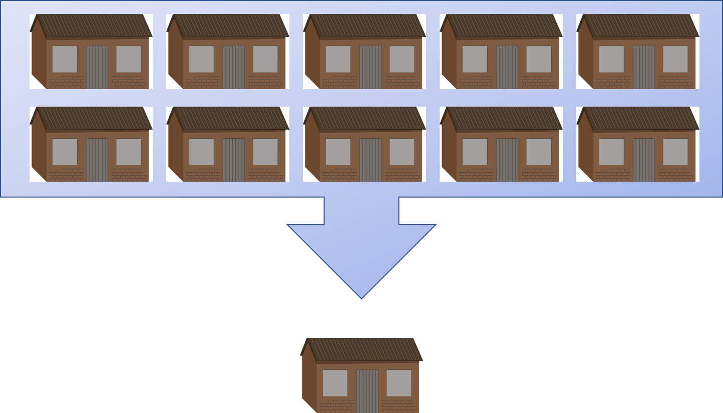
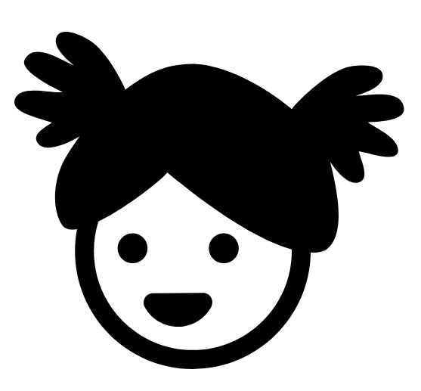
Anthropometry Remeasurements
Obtaining accurate height/length and weight measurements especially for young children is difficult to collect in the field.
Even small measurement errors can result in invalid data.
A subset of children will be remeasured in the survey to assess and correct wrong measurements.
Child 0-71 months

Slide 3
Reasons for Remeasurement of Height and Weight
Random: Children will be randomly selected for remeasurement. Comparing the anthropometrist’s first measurement and revisit measurement.
Flagged: Children will be flagged for remeasurement when the first measurement resulted in an extreme anthropometry z-score. This is done to reduce invalid data in the survey.
Notes:
All team members are blinded to the reason the child has been selected for remeasurement.
Children selected for remeasurement may not actually have incorrect measurements.
Children selected for a random check
Not all flagged cases will be incorrect.

Slide 4
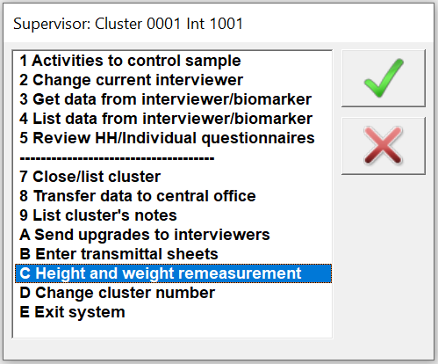
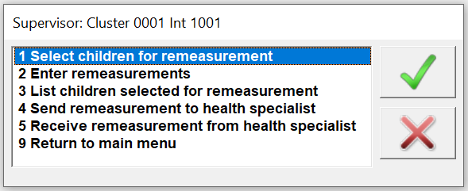
Procedures for Remeasurement
Supervisor to select children and produce report
Report provides information on the children selected for remeasurement.
Report will only run once all the anthropometry data has been entered for the cluster.

Slide 5
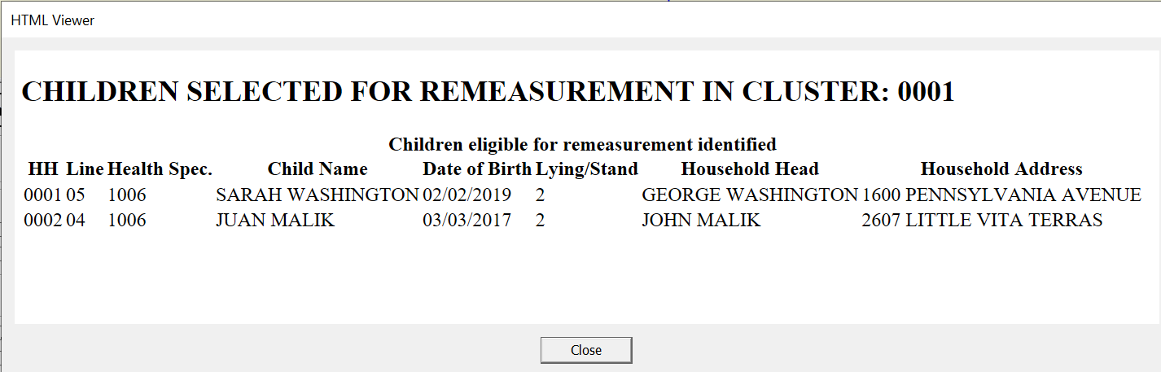
Procedures for Remeasurement
Supervisor will fill in the cover page and information on the child in an Anthropometry Questionnaire per household for each child selected for remeasurement.
Supervisor MUST fill this information when the anthropometrist and the assistant are not present.
Supervisor to provides pre-filled qres to HW

Slide 6
Procedures for Remeasurement
Only children whose information is in the Anthropometry Questionnaire will be remeasured in the household.
The cluster cannot be closed until all remeasurement Anthropometry Questionnaire data have been completed and entered into CAPI.

Slide 7
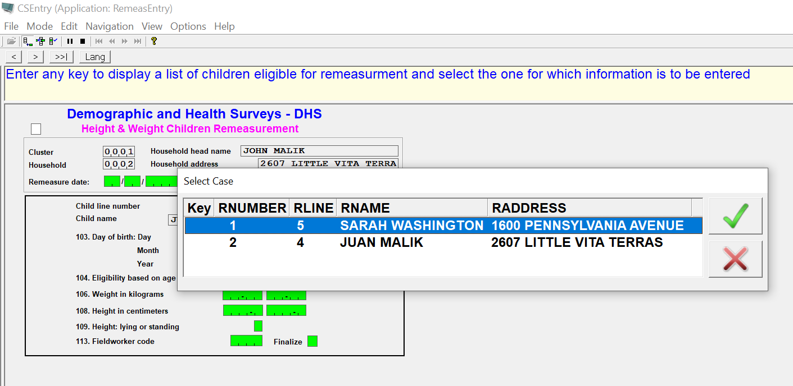
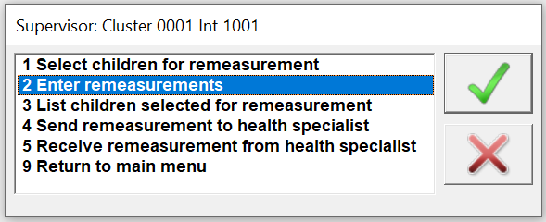
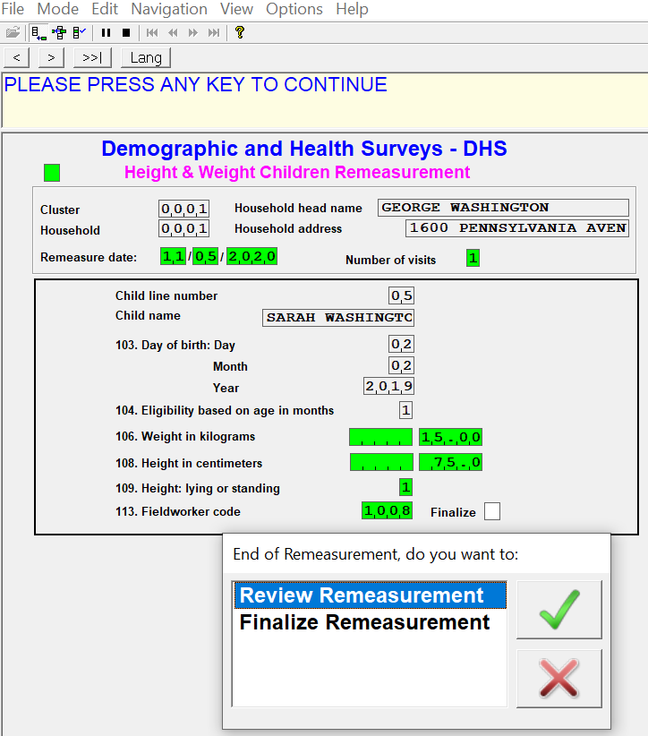
Procedures for Remeasurement
The anthropometrist will return the Anthropometry Questionnaires to the Supervisor to be entered into CAPI.

Slide 8
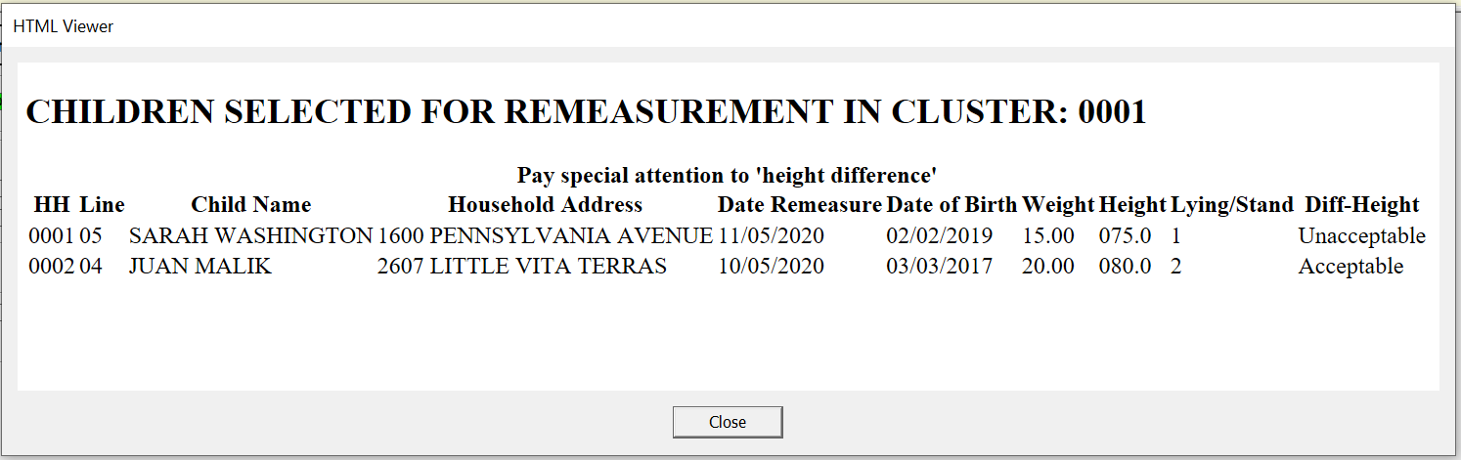
Procedures for Remeasurement
Notes:
After completion of all remeasurements, the absolute difference between the first and revist measurement will be compared automatically in the tablet. This will only be done for the children randomly selected.
The Quality Control will communicate to the anthropometrist whether the height was acceptable (<1 cm) from the random remeasurements. This is for supervision purposes. The anthropometrist will not be required to return and remeasure subjects when unacceptable difference is found between the measurements.
The completed Anthropometry Questionnaires from the first measurement and the remeasurements should be included with the other materials and sent back to the central office when fieldwork in the cluster is completed.

Slide 9
THANK YOU

